Slide 1
ITP4512 Enterprise Software Lecture 2 Basic Information on ABAP
IT114105 Higher Diploma in Software Engineering

Slide 2
Module Intended Learning Outcomes
At the end of this topic, you will be able to:
perform some common daily operations of major modules of an ERP system;
customise an ERP system using an appropriate programming environment; and
develop programs to support the integration of business transactions among business partners in the supply chain.

Slide 3
Lesson Intended Learning Outcomes
At the end of this topic, you will be able to:
declare data object in ABAP programing
write output in ABAP report
develop ABAP program with predefined functions and control blocks

Slide 4
Basic Syntax

Slide 5
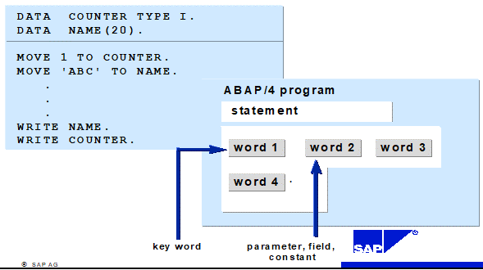
Statements
Each statement begins with a keyword and ends with a
period (.)

Slide 6
Keywords
The first word of a statement which determines the use of the entire statement
Types of Keywords
Declarative keywords
Defines data type or declare data object
Example - TYPES, DATA, TABLES
Modularization keywords
Defines the processing block in an ABAP program
The modularization keywords can be further divided into:
Event Keyword
Example - AT SELECTION SCREEN, START-OF-SELECTION, AT USER-COMMAND
Defining Keyword
Example - FORM ..... ENDFORM, FUNCTION ..... ENDFUNCTION, MODULE ..... ENDMODULE

Slide 7
Keywords
Types of Keywords
Control keywords
Controls the flow of an ABAP program within a processing block
Example - IF, WHILE, DO, FOR, CASE
Calling keywords
Calls processing blocks that you have already defined
Example - PERFORM, CALL, SET USER-COMMAND, SUBMIT, LEAVE TO
Operational keywords
Processes the data that you have defined using declarative statements
Example - WRITE, MOVE, ADD

Slide 8
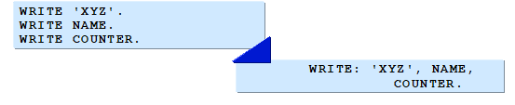
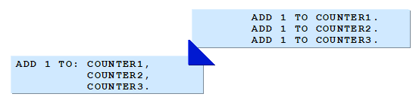
Chain Statements
You can concatenate several consecutive statements with an identical first part into a chain statement
When doing this, conclude the identical first part with a colon (:)
After the colon, separate each concatenated part from the next with a comma (,)

Slide 9
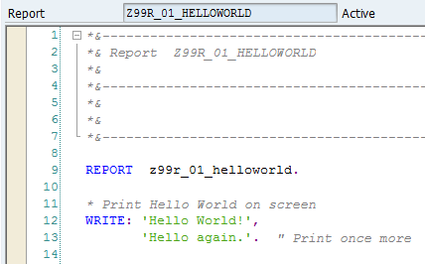
Comments
Texts which are written between the statements to explain the purpose
Comment is flagged by special characters which causes system to ignore them
ABAP comments:
An asterisk (*) in column 1 flags the whole line as a comment
A quotation mark (") within a line flags the remainder of the line as a comment

Slide 10
ABAP Program Layout
To write a high-quality program, you should keep certain layout standards for ABAP Program
Follow when structuring your program flow, and use as many as informative comments as possible
If you follow these suggestions your program will be
More readable
Easier to test and change
More reliable

Slide 11
ABAP Program Layout
To improve the quality of your programs, use the following techniques:
Indenting statement block
Combine statements that belong together into a single block
Indent each block by at least two columns
Using modularization tool
Write larger processing blocks as subroutines, the logical structure of the program becomes easier to identify
It also allows you to sort the subroutines according to the tasks they perform
Inserting program comment
Avoid placing comments on statement line
Place comment on separate line to improve the readability of the program
Insert subroutine heading and comment in your program by using the ready-made structures available in ABAP Editor

Slide 12

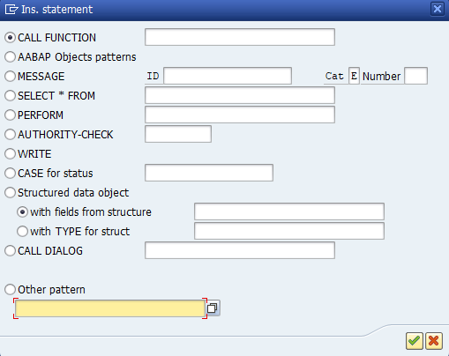
Ready-made Structure
Provides the exact syntax and follows the ABAP layout guidelines
Clicks Pattern from ABAP Editor toolbar
You can insert two kinds of ready-made structures
Ready-made keyword structures
Ready-made comment lines
You may select other structures from Other pattern

Slide 13
Data Declaration

Slide 14
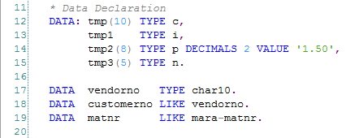
DATA Statement
Declare data object
* Syntax
DATA var[(length)] [TYPE type | LIKE Table-Field]
[Decimals number] [VALUE initial value].

Slide 15
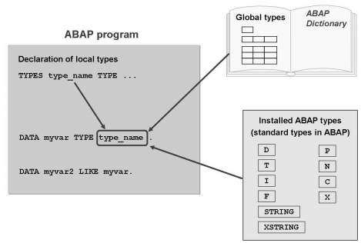
Data Types
Describes the technical attributes of all the objects with that type
There are three categories of types
Predefined standard
Local
Global

Slide 16
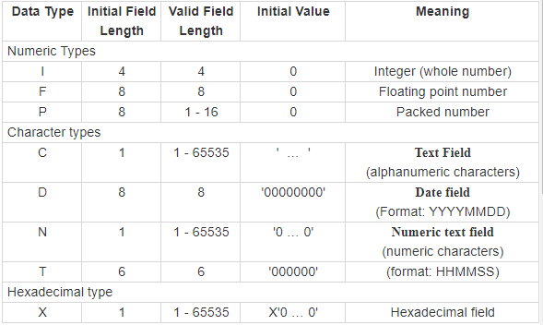
Predefined Types with Fixed Length
Generic types
When you use a generic type to define a local data type in a program or a data object, you must specify the field length and, in the case of type P, the number of decimal places.
You have to use type P data to meet accuracy or value range requirements.
Ref: https://help.sap.com/saphelp_nw70/Helpdata/en/fc/eb2fd9358411d1829f0000e829fbfe/content.htm?no_cache=true

Slide 17
Predefined Types with Variable Length
Lengths are not fixed until runtime
STRING - A string is a sequence of characters with variable length
XSTRING - A byte string is a hexadecimal type with variable length

Slide 18
Local Data Type
Types only exist in the program and hence can only be used there
To define your own local data type, use the TYPES statement
Example:
TYPES fnumber TYPE I.
DATA flightANum TYPE fnumber.

Slide 19
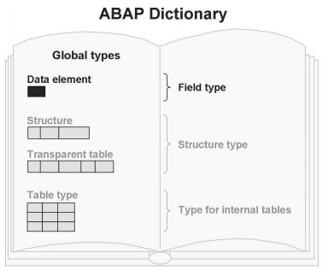
Global Data Type
Defined in the ABAP Dictionary
Can be used throughout the entire system
Examples:
mara is a table
matnr is a field in table mara

Slide 20
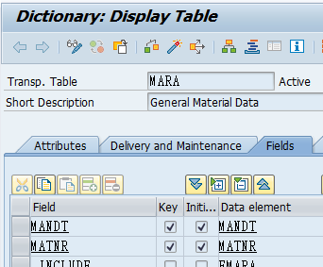
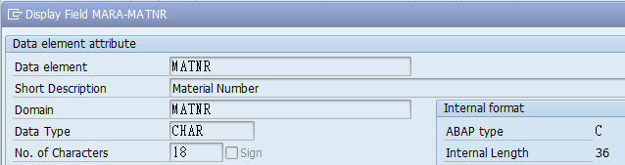
Global Data Type
SE11
Double click

Slide 21

CONSTANTS Statement
Constant declaration
* Syntax
CONSTANTS const [TYPE type] VALUE initial value.

Slide 22
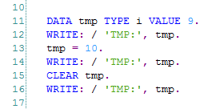

CLEAR Statement
Clear value of data object
* Syntax
CLEAR <data object>.

Slide 23
ABAP Outputs

Slide 24
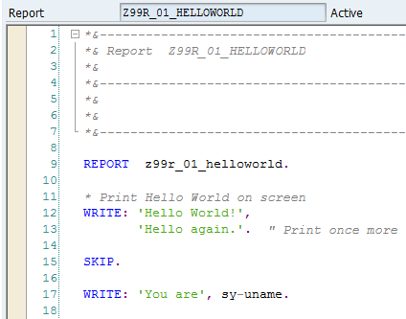
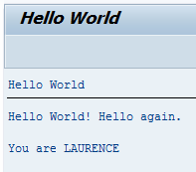
WRITE Statement
WRITE statement outputs the contents of a field or constant in the format appropriate for the type

Slide 25

WRITE Statement
Consecutive WRITE statements output data on the same line separated with one space
WRITE 'Hello’.
WRITE 'World'.
If there is no more space on one line, the output continues on the next line
Slash (/) in the WRITE statement will start the output on a new line
WRITE 'Hello’.
WRITE / 'World'.

Slide 26
WRITE Statement
* Syntax
WRITE <f> <AT position(length)>
<OPTION>
<AS CHECKBOX>
<AS SYMBOL>
<AS ICON>
<AS LINE>

Slide 27

WRITE Position
WRITE output at a specific position
It may replace characters on the same line
WRITE 'Hello'.
WRITE 8 'World'.
WRITE /6 'Password'.
WRITE 7 ‘@’.
Use AT if the position is a field
DATA pos TYPE I VALUE 8.
WRITE AT pos 'World'.

Slide 28

WRITE length
WRITE outputs with fewer characters if length is too short
WRITE (3) ‘Hello’. ➔ Hel
WRITE reserves space(s) if the length is too long
Text is left-justified, number is right-justified
WRITE (5) 'xyz'.
WRITE 'abc’.

Slide 29

WRITE P-type Data
The initial field length is 16
Thousand separator and decimal point could be period (.) or comma (,) depend on owner’s profile
The last character is reserved for sign
Space : positive number
- : negative number
Example
DATA num1 TYPE p DECIMALS 1 VALUE '1234.5'.
WRITE num1.
DATA num2 TYPE p DECIMALS 1 VALUE '-1234.5'.
WRITE / num2.

Slide 30
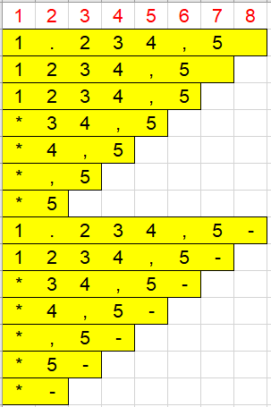
WRITE P-type Data
Outputs will be truncated if the length is too short
Example
DATA num1 TYPE p DECIMALS 1 VALUE '1234.5'.
WRITE /(8) num1, /(7) num1,
/(6) num1, /(5) num1,
/(4) num1, /(3) num1,
/(2) num1.
DATA num2 TYPE p DECIMALS 1 VALUE '-1234.5'.
WRITE /(8) num2, /(7) num2,
/(6) num2, /(5) num2,
/(4) num2, /(3) num2,
/(2) num2.

Slide 31
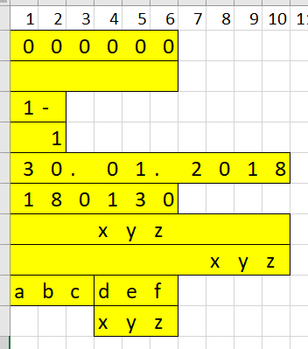
WRITE Options
DATA num1 TYPE T.
WRITE / num1.
WRITE / num1 NO-ZERO.
DATA num2 TYPE p VALUE '-1'.
WRITE /(2) num2.
WRITE /(2) num2 NO-SIGN.
WRITE / SY-DATUM.
WRITE / SY-DATUM yymmdd.
WRITE /(10) 'xyz' CENTERED.
WRITE /(10) 'xyz' RIGHT-JUSTIFIED.
WRITE : / 'abc' NO-GAP, 'def'.
WRITE / 'xyz' UNDER 'def'.

Slide 32

WRITE Options
LEFT-JUSTIFIED
CURRENCY w - to treat the content of field <f> as a currency amount with w as a currency key
DECIMALS d - to determine number of decimals to be displayed
UNIT u - to format the value according to the unit specified in the field u
Example:

Slide 33
Common System Fields
Name | Type | Length | Meaning
SY-DATUM | DATS | 8 | Current Date of Application Server
SY-UZEIT | TIMS | 6 | Current Time of Application Server
SY-UNAME | CHAR | 12 | User Name
SY-SUBRC | INT4 | 10 | Return Value of ABAP Statements
SY-CPROG | CHAR | 40 | Calling Program
SY-TCODE | CHAR | 20 | Current Transaction Code
SY-LANGU | LANG | 1 | Language Key of Current Text Environment

Slide 34
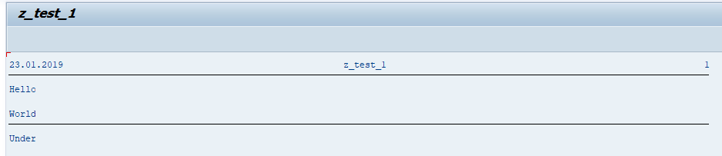
SKIP, ULINE
SKIP – creates a line space
ULINE – creates a horizontal line
Example
WRITE 'Hello'.
SKIP.
WRITE 'World'.
ULINE.
WRITE 'Under'.

Slide 35
ABAP Operators and Functions

Slide 36
Arithmetic Operations
Operator | Operation
+ | Addition
- | Subtraction
* | Multiplication
/ | Division
DIV | Integral division without remainder
MOD | Remainder after integral division
** | Exponentiation

Slide 37
Arithmetic Operations
Operation | Statement using mathematical expression | Statement using keyword
Addition | m = m + n. | ADD n TO m.
Subtraction | m = m - n. | SUBTRACT n FROM m.
Multiplication | m = m * n. | MULTIPLY m BY n.
Division | m = m / n. | DIVIDE m BY n.
Integral division without remainder | p = m DIV n. | -
Remainder after integral division | p = m MOD n. | -
Exponentiation (Powers) | p = m ** n. | -
Square root | p = SQRT(m). | -

Slide 38
Relational Operator
Operators | Operations
EQ = | Equal to
NE <> >< | Not equal to
GT > | Greater than
GE >= => | Greater than or equal to
LT < | Smaller than
LE <= =< | Smaller than or equal to
BETWEEN f1 and f2 | Interval
IS INITIAL | Initial value

Slide 39
Arithmetic Operations
Operators | Operation | Example
<f1> CO <f2> | Contains only: f1 contains only characters from f2 | 'SE2A' CO '0123456789’ return false
<f1> CA <f2> | Contains any: f1 contains at least one character from f2 | '432’ CA '0123456789’ return true
<f1> CS <f2> | contains string: f1 contains the string f2 | '432’ CS '0123456789’ return false
<f1> CP <f2> | contains pattern: f1 corresponds to the model f2 Model: * any string + any character # escape symbol | 'ABXDE' CP '*B+D*’ return true

Slide 40
Logical Expression
AND, OR, NOT
Examples
COUNTER GT 0 AND FLAG IS INITIAL
( FLAG1 NE SPACE OR FLAG2 NE SPACE )
AND COUNTER BETWEEN 0 AND 100
COUNTER EQ 0 AND NOT ( FLAG1 EQ SPACE AND FLAG2 EQ SPACE )

Slide 41
Predefined Functions
ABAP provides a set of predefined functions
Returns a return value for one or more arguments
Syntax
Function with an Unnamed Argument
... func( arg ) ...
Function with Named Arguments
... func( val = arg p1 = arg1 p2 = arg2 ... ) ...

Slide 42
Predefined Functions - Logical Function
Function | Meaning
boolc, boolx | Boolean Functions
contains, contains_any_of, contains_any_not_of | Predicate functions for strings
matches | Predicate Function for Strings

Slide 43
Predefined Numerical Functions
Function | Meaning
abs, ceil, floor, frac, sign, trunc | General numerical functions
nmax, nmin | Numerical extremum functions
acos, asin, atan, cos, sin, tan, cosh, sinh, tanh, exp, log, log10, sqrt | Floating point functions
round, rescale | Rounding functions

Slide 44
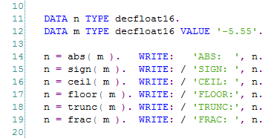
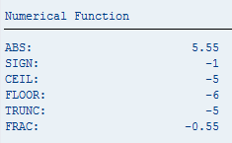
Predefined Numerical Functions

Slide 45
Predefined String Functions
Function | Meaning
char_off, charlen, dbmaxlen, numofchar, strlen | Length functions
cmax, cmin | Character-like extremum value functions
count, count_any_of, count_any_not_of | Search functions
distance | Similarity function
condense | Condense function
concat_lines_of | Concatenation function
escape | Escape symbol function
find, find_end, find_any_of, find_any_not_of | Search functions

Slide 46
Predefined String Functions
Function | Meaning
insert | Insert function
match | Substring function
repeat | Repeat function
replace | Replace function
reverse | Reverse function
segment | Segment function
shift_left, shift_right | Shift functions
substring, substring_after, substring_from, substring_before, substring_to | Substring functions
to_upper, to_lower, to_mixed, from_mixed | Case functions
translate | Translation function

Slide 47
Predefined Byte String Functions
Function | Meaning
xstrlen | Length function
bit_set | Bit function

Slide 48
Predefined Table Function
Function | Meaning
lines | Row function

Slide 49
Control Blocks

Slide 50
Looping Operation
Four Types of loop in ABAP:
Unconditional loop using the DO statement
Conditional loop using the WHILE statement
Loops through internal table and extract dataset using the LOOP statement (will be introduced in other chapter)
Loops through datasets from database table using SELECT statement (will be introduced in other chapter)

Slide 51

Looping Operation - DO Statement
Example
DO 3 TIMES.
WRITE /(2) SY-INDEX.
WRITE 'Hello'.
ENDDO.

Slide 52
Looping Operation - WHILE Statement
Example
DATA cnt TYPE i VALUE 3.
WHILE cnt >= 1.
WRITE /(2) SY-INDEX.
WRITE 'Hello'.
cnt = cnt - 1.
ENDWHILE.

Slide 53
CONTINUE Statement
Bypass the following statements in a loop and go to next iteration
Example:
DATA rem TYPE i.
DO 20 TIMES.
rem = SY-INDEX MOD 5.
IF rem EQ 0.
CONTINUE.
ENDIF.
WRITE (2) SY-INDEX.
ENDDO.

Slide 54
CHECK Statement
Bypass the following statements in a loop and go to next iteration if the condition return FALSE
Example:
DATA rem TYPE i.
DO 20 TIMES.
rem = SY-INDEX MOD 5.
CHECK rem EQ 0.
WRITE (2) SY-INDEX.
ENDDO.
Terminate a subroutine conditionally

Slide 55
EXIT Statement
Terminate a loop or subroutine
Example:
DATA rem TYPE i.
DO 20 TIMES.
rem = SY-INDEX MOD 5.
IF rem EQ 0.
EXIT.
ENDIF.
WRITE (2) SY-INDEX.
ENDDO.

Slide 56
IF Statement
Example:
DATA mark TYPE i VALUE 50.
IF mark <= 40.
WRITE 'F'.
ELSEIF mark <= 60.
WRITE 'B'.
ELSE.
WRITE 'A'.
ENDIF.

Slide 57
CASE Statement
Example:
DATA grade TYPE c VALUE 'A'.
CASE grade.
WHEN 'A'.
WRITE 'Excellent'.
WHEN 'B'.
WRITE 'Good'.
WHEN OTHERS.
WRITE 'Bad'.
ENDCASE.

